Slide 1

Accelerated grey matter degeneration in relapsing remitting multiple sclerosis

Slide 2

Contens
Background
Methods
Results from two studies
Interpretation

Slide 3
Background
Notes:
MS is a neurological disorder, and hence looking at brain imaging data comes natural to learn something about brain-based processes
These could be by quantifying lesions, differnet tissue types and the development of such, for example grey matter atrophy
The key starting point are quanitfyable and comparable data

Slide 4
Background
Different approaches can be used to quantify images
Notes:
Different approaches can be used to quantify images to allow for statistical assessments
magnetic resonance imaging provides the most detailed spatial information and I will focus on that
To make quantification scalable, automatised pipelines are applied – another point I will focus on

Slide 5
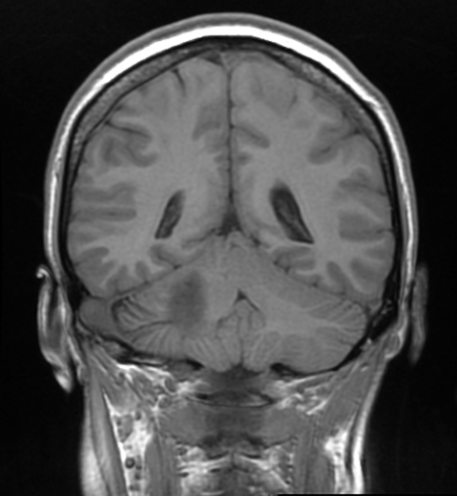
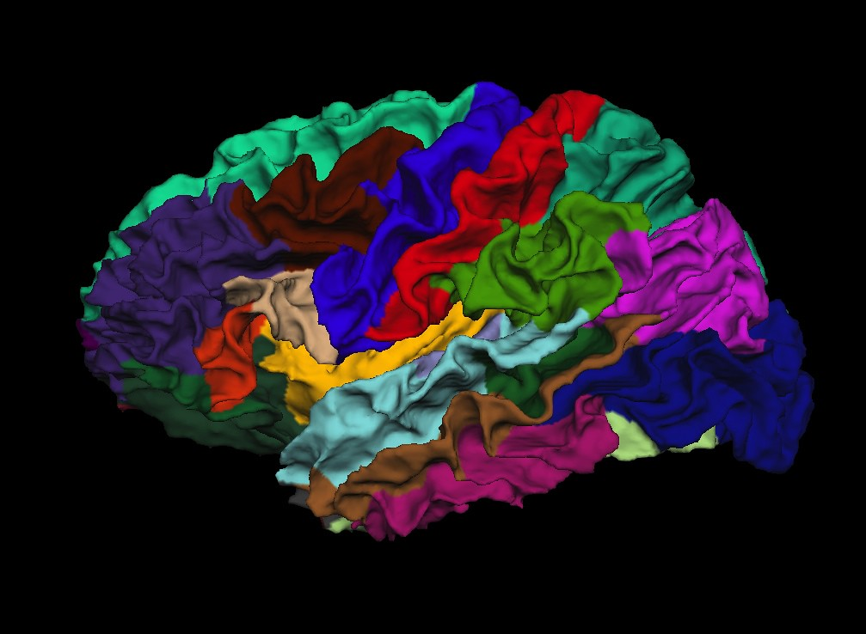
Background
Different approaches can be used to quantify images
Different magnetic resonance imaging modalities for different purposes
T1w MRI
Atlas based parcellation
Tabularized data
Volume left suppl left sup.
in mm³ motor cort frontal lobe
------------------------------------------------
Sub1 2825.41 10939.1
Sub2 3227.39 14993.3
Sub3 2919.22 10846.9
Brain parcellation image by Jgmarcelino at flickr
Notes:
Different magnetic resonance imaging modalities for different purposes
Here I will focus on T1-weighted imaging using sequences such as MPRAGE which are standard acquisitions both clinically and in research (Magnetization Prepared RApid Gradient Echo)
T1-weighted images can be spatially aligned, segmented based on an anatomical atlas, and then statistically compared

Slide 6
Background
Grey matter loss is a feature of MS
This pattern seems to particularly affect specific brain regions^{1,2}
Images: Wikimedia, Lansey et al. (2013) Neurosci. Biobehav. Rev., Eshagi et al. (2018) Brain
Notes:
Atrophy is a known characteristic in MS
However, it is yet unclear how to quantify atrophy from a single MRI, where atrophy = process !!!
Hence, longitudinal data are necessary
Yet there is little data on the longitudinal degeneration
Additionally, it is unclear whether there is a stereotypical brain morphometric phenotype of MS.
This requires large epidemiological comparison samples

Slide 7
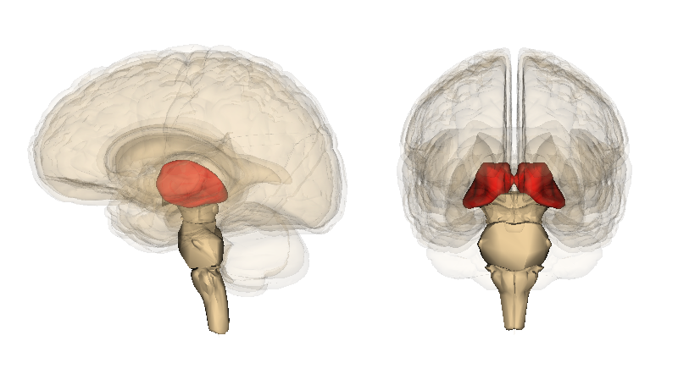
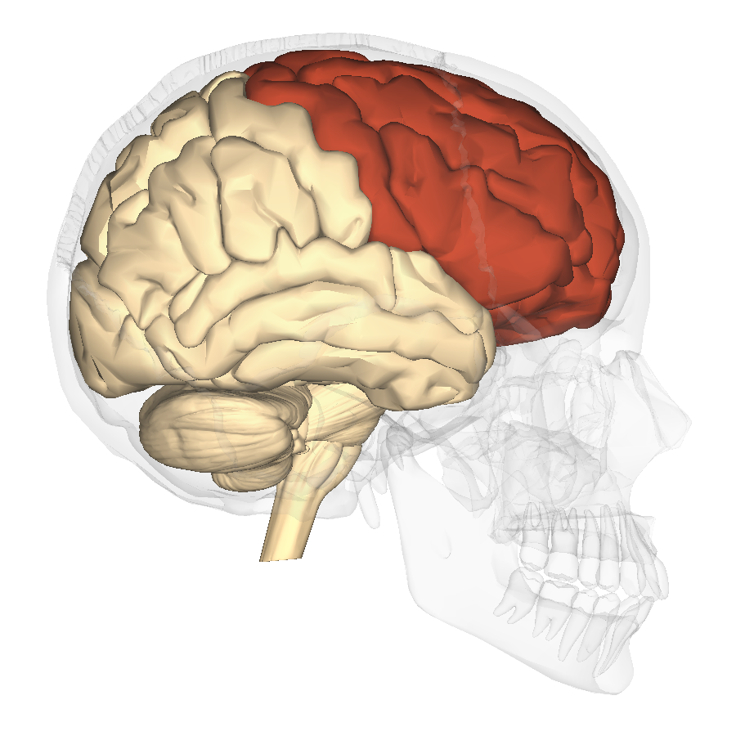
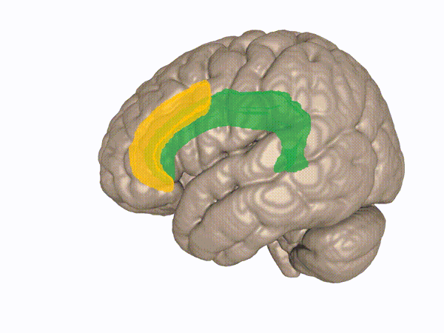
Background
Grey matter loss is a feature of MS
This pattern seems to particularly affect specific brain regions^{1,2}
Thalamus
Frontal lobes
Cingulate
Thalamus
Frontal lobe
Cingulate
Images: Wikimedia, Lansey et al. (2013) Neurosci. Biobehav. Rev., Eshagi et al. (2018) Brain
Notes:
Still, there are some studies proposing that atrophy patterns are region-specific, often suggesting
Thalamus
Frontal lobes
Cingulate gyrus
Problem: No systematic assessments, no comparison to healthy ageing >> Hence, we conducted two studies

Slide 8
Methods
Two (relapsing remitting) MS cohorts (N=386, T₁w-scans=940) sampled for up to 12 years; clinical assessments: EDSS, PASAT, FSS
Notes:
We used two different cohorts, on from a multicenter clinical trial across Norway and one local dataset collected along clinical assessments in Oslo
MRI assessments, expanded disability status scale, Paced Auditory Serial Addition Test, Fatigue Severity Scale used

Slide 9
Methods
Two (relapsing remitting) MS cohorts (N=386, T₁w-scans=940) sampled for up to 12 years; clinical assessments: EDSS, PASAT, FSS
Data used in two studies mapping most significantly atrophying brain regions and their clinical importance
Slightly different foci across studies:
Is there accelerated atrophy in MS? (study 1)
Is there a clinically translatable brain morphometric phenotype in MS? (study 2)
Group comparisons (to 2 163 HCs) vs (individual specific) reference values (from 62 431 HC)
Notes:
We executed two studies with the goal of closer approximating an answer to what the pattern of atrophy in MS looks like
Sub-questions were
whether there actually is accelerated atrophy when comparing with HCs with atrophy, and
Whether there is a stereotypical brain morphometric phenotype of MS
We used different statistical approaches, where …
the first question was tested with traditional statistics comparing the atrophy trajectories (longitudinally) of our MS vs HC cohort
The second question was tested using normative models or age- and sex specific reference values established from a large lifespan cohort HC

Slide 10
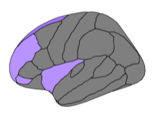
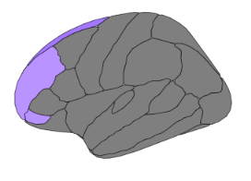
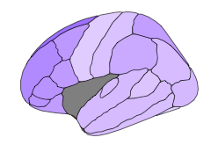
Study 1
Multiple Sclerosis
Clinical score
Overlap
Brain volume
Brain volume
Time
1. What are the brain atrophy patterns in MS and their overlap with disability accumulation?
Korbmacher et al. (2025) medRxiv. https://doi.org/10.1101/2025.07.01.25330635
Notes:
First, we estimated the slopes / regression lines indicating …
the atrophy over time, as well as …
the longitudinal associations between clinical score (EDSS, PASAT, FSS) of each brain region …
The two patterns were then overlapped to see which significantly atrophying regions were also clinically significant

Slide 11
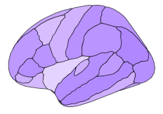
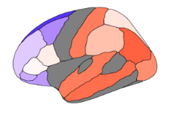
Study 1
Multiple Sclerosis
Clinical score
Overlap
Healthy Controls
Brain volume
Ageing comparison: MS vs healthy agers
Brain volume
Brain volume
Time
Time
1. What are the brain ageing patterns in MS and their overlap with functional loss?
2. Do brains of people with MS age faster than those of older healthy agers?
Korbmacher et al. (2025) medRxiv. https://doi.org/10.1101/2025.07.01.25330635
Notes:
Second, we looked at the ageing trajectories of HCs who were circa 20 years older
Why 20 years older HCs?
The reason is that before the age of 45, atrophy is very slow in healthy controls
due to measurement error, it is nearly impossible to observe it
Hence, we use an older age to be sure to observe atrophy

Slide 12
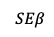
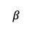
How to estimate differences in ageing trajectories?
Study 1
Multiple sclerosis vs healthy controls
Volume
$$α$$
$$β$$
$$SEβ$$
Time
Time
What are the brain ageing patterns in MS and their overlap with progression?
Korbmacher et al. (2025) medRxiv. https://doi.org/10.1101/2025.07.01.25330635
Notes:
First, slopes and standard errors are estimated for each brain region

Slide 13
Study 1
Multiple sclerosis vs healthy controls
Volume
$$α$$
$$β$$
$$SEβ$$
Time
Time
Comparison of slopes
$$\frac{α−β}{\sqrt{({SEα)}^{2}+({SEβ)}^{2}}}$$
What are the brain ageing patterns in MS and their overlap with progression?
Korbmacher et al. (2025) medRxiv. https://doi.org/10.1101/2025.07.01.25330635
Notes:
- These estimates or slopes can then be compared in a simple formula

Slide 14
Study 1
Multiple sclerosis vs healthy controls
Volume
$$α$$
$$β$$
$$SEβ$$
Time
Time
Comparison of slopes
$$\frac{α−β}{\sqrt{({SEα)}^{2}+({SEβ)}^{2}}}$$
Blue = faster ageing in MS than in 20 year old healthy agers (UKB), grey = no sign. diff, white = difference close to zero
What are the brain ageing patterns in MS and their overlap with progression?
Korbmacher et al. (2025) medRxiv. https://doi.org/10.1101/2025.07.01.25330635
Notes:
Which provides a map of blue regions of, again, much younger people with MS showing faster atrophy rates
Grey means no difference, which is still impressive an impressive finding considering the older age of the HCs
And red meaning the HCs’ atrophy progresses faster
What was highlighted here were the frontal lobes ageing FASTER than during healthy ageing later in life
One can conclude that there is accelerated ageing in these areas in MS

Slide 15
Regions atrophy across samples
Study 1
Korbmacher et al. (2025) medRxiv. https://doi.org/10.1101/2025.07.01.25330635
Notes:
Blue colour = significant atrophy in the particular region
Grey = non-significant
The strongest replicable effect of age on grey matter volume were found in both hemispheres of the SFC and thalami
However, you can see that the atrophy is spread across the parietal and temporal lobes as well

Slide 16
Regions atrophy across samples
Study 1
Korbmacher et al. (2025) medRxiv. https://doi.org/10.1101/2025.07.01.25330635
Notes:
Note that in accordance with these findings, disability (EDSS) was strongest associated with thalamic volumes over time

Slide 17
Accelerated ageing / atrophy in MS?
Study 1
Caudal middle frontal cortex
Sup.frontal
Korbmacher et al. (2025) medRxiv. https://doi.org/10.1101/2025.07.01.25330635
Notes:
Blue colour = accelerated atrophy in MS
We used the mentioned two samples to replicate / validate observed atrophy patterns
Atrophy accross MS samples was faster than in older HCs in the superior frontal lobes, caudal middle frontal lobes, as well as the subcortical structure caudate (not visible here)
Note that for many other regions there was either no clear difference between MS and HC or no overlap between the two MS cohors

Slide 18


Study 2
Cross-Sectional Norm Deviations in Multiple Sclerosis
Establishing Normative Models from Healthy Controls
Brain volume
Age
Brain volume
Longitudinal Changes in Norm-Deviations in Multiple Sclerosis
Age
Brain volume
Age
Notes:
Slightly different strategy for study 2
We used around 60 000 HC to establish region-wise normative models (multivariate fractional polynomial regression models)
This was done to establish sex and age specific regional brain volume reference values
We then looked at norm deviations in people in MS

Slide 19
Study 2
Cross-Sectional Norm Deviations in Multiple Sclerosis
Establishing Normative Models from Healthy Controls
Brain volume
Age
Brain volume
Longitudinal Changes in Norm-Deviations in Multiple Sclerosis
Age
Brain volume
Age
Notes:
Advantage: personalised scores, which can be used clinically

Slide 20
Brain morphometric phenotype of MS
Study 2
Deviation % indicates of how many participants with MS had a significant deviation from the norm in the specific brain region.
Korbmacher et al. (2025b) unpublished data.
Notes:
A large proportion of people with MS had significantly lower-than-reference brain volumes in the thalamus
I say large, because there are rarely disorders with such a large overlap across patients
This phenotype was stable over time
That is a good criterion for early diagnosis

Slide 21
Brain morphometric phenotype of MS
Study 2
Deviation % indicates of how many participants with MS had a significant deviation from the norm in the specific brain region.
Korbmacher et al. (2025b) unpublished data.
Notes:
The total number of deviations across brain areas (on average around 6% of all regions) were associated with disability / EDSS and fatigue / FSS

Slide 22
Brain morphometric phenotype of MS
Study 2
Deviation % indicates of how many participants with MS had a significant deviation from the norm in the specific brain region.
Korbmacher et al. (2025b) unpublished data.
Notes:
Additionally, thalamic deviations were mostly indicative of disability

Slide 23
Brain morphometric phenotype of MS
Study 2
Deviation % indicates of how many participants with MS had a significant deviation from the norm in the specific brain region.
Korbmacher et al. (2025b) unpublished data.
Notes:
Praecuneus and superior frontal deviations were strongest associated with fatigue (FSS) and processing speed (PASAT), respectively.

Slide 24
Interpretation
Thalamus and superior frontal lobe (SFL) are key areas of MS
Thalamus: key region to identify MS, predictive of disability
SFL: fastest and accelerated atrophy, predictive of cognitive processing speed
Brain reference values can be used as a personalised medicine tool by providing individual-specific
Notes:
Thalamus and superior frontal lobe (SFL) are key areas describing MS
Norm-deviations in thalamic volume might be clinically relevant for diagnosis and prognosis, as there is large overlap between patients in having lower thalamic volumes
Thalami are particularly predictive of disability progression
Brain reference values can be used as a personalised medicine tool by providing individual-specific scres
These scores can be used diagnostically and prognostically BEFORE atrophy is visually detectable
Therefore they are promising

